Slide 1
Stock Returns Graphical User Interface with Python Ata Yatırım Menkul Kıymetler A.Ş / Emirhan Cad. No:109 K:12 Atakule, Beşiktaş, İstanbul, 34349, Türkiye
July 10 – September 15 2023
Can Ceylan / BSCS – Computer Science and Engineering

Slide 2
Motivation behind the project
We want to easily see how certain stocks have moved, along with some statistics to understand the stock market behaviour.
‘Matriks Data’ software already has a GUI for this, but it lacks some of the features that we desire:
You can not have custom category of stocks, it only works with some predetermined categories of stocks
You can not specify return types, it only displays compounding close-close return types.
You can not enter a specific date interval, only works for intervals like 1 week, 1 month, 3 months, 1 year, etc.
You can not apply certain filters that you might want to.

Slide 3
Project Objective
Create an easy to use graphical user interface that allows user to specify:
Category of stocks,
Date interval,
Return type,
Sorting method,
Filters,
Configure which statistics to display;
and compute and display the desired statistics over an easy to interpret grid.

Slide 4


Methods and Tools
The main tool that I have used is called ‘Spyder’, which is an IDE designed to be used with Python.
To import necessary packages, I have used Anaconda.

Slide 5
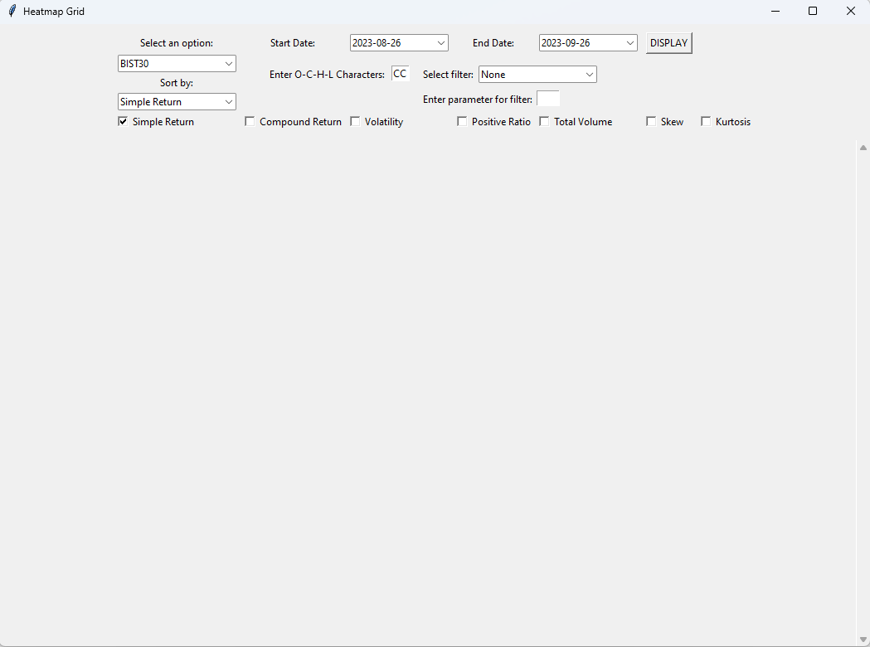
The GUI Application

Slide 6
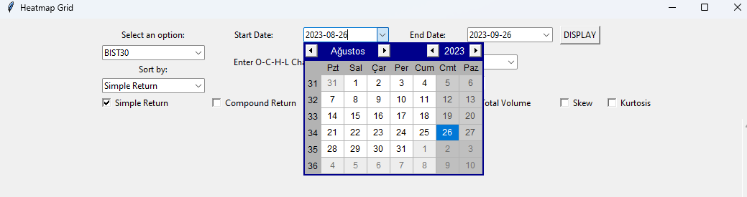
The GUI Application: Date entry
The dates can be entered easily by clicking the button and choosing the date from the calendar.
Only the information between the specified dates will be used to caclulate the desired statistics.
The default dates are: (today – 1 day – 1 month) – (today – 1 day)

Slide 7
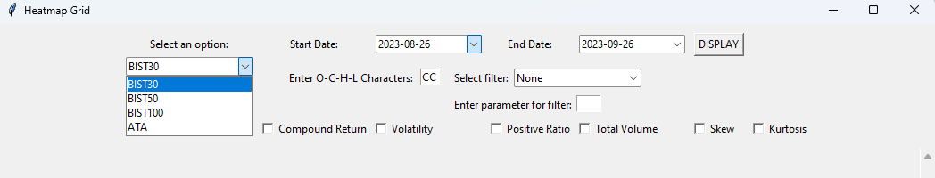
The GUI Application: Category of stocks selection
User can choose an option from the categories that were implemented in the GUI application.
If the user wants to create a specific category of their own, it can easily be implemented through the Python script.

Slide 8
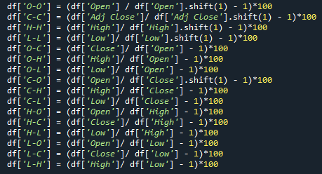
The GUI Application: Return Type Entry
User can enter any combination of (O,C,H,L) characters.
O => Open
C => Close
H => High
L => Low

Slide 9
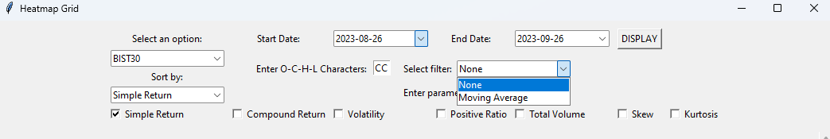

The GUI Application: Filter selection
User can choose to apply a filter to the calculation.
If the filter requires an additional parameter, it can be entered at the parameter field.
Moving average of X days: buy/sell only on days where MA of X days is smaller than that days price.

Slide 10
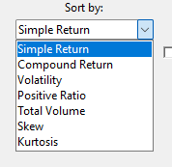
The GUI Application: Sort by option, and choosing which statistics to be displayed
User can choose to sort the results according to which statistic.
User can also choose which statistics will be displayed.

Slide 11
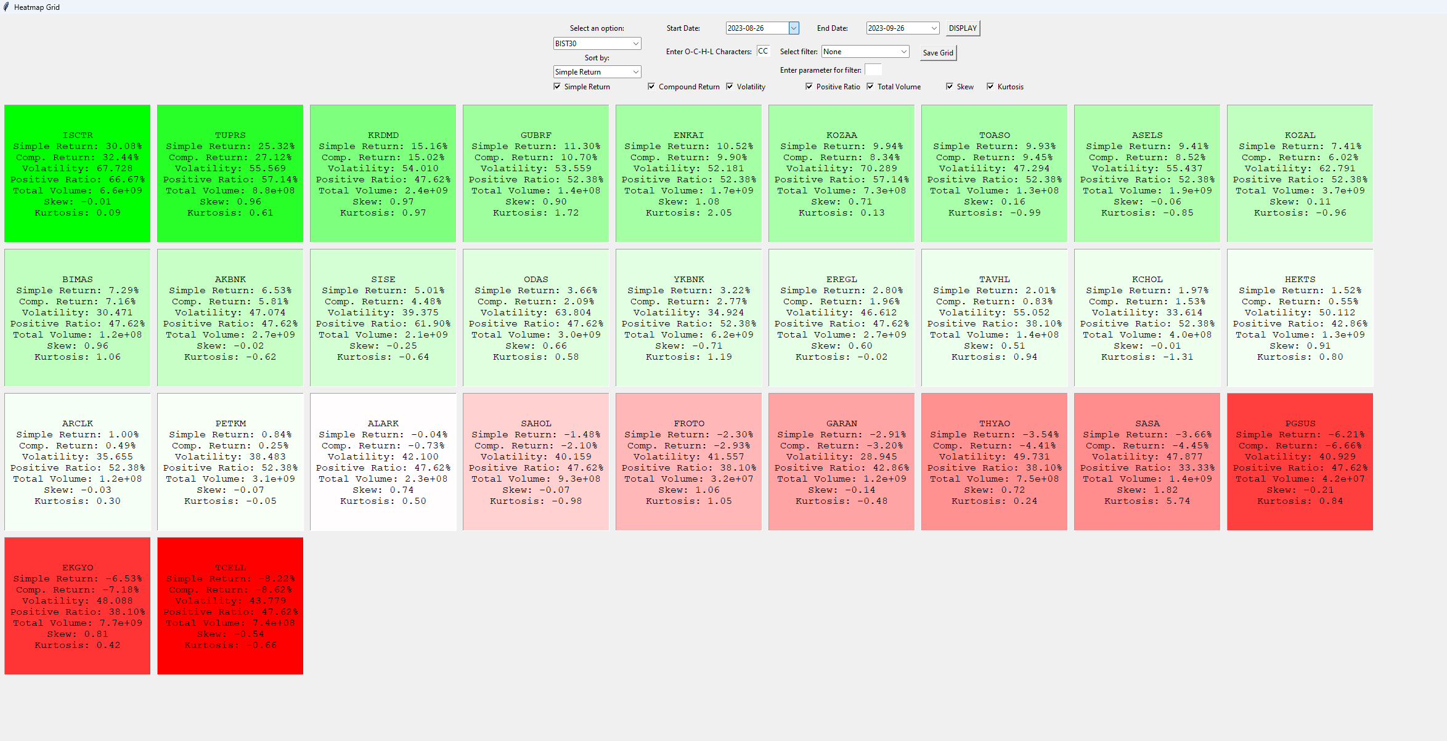
The GUI Application: The Grid
After user pushes the DISPLAY button, an input check is done and appropriate error message is displayed to the user if something is wrong. If inputs are correct, a grid will be drawn accordingly.
User can save the results as a csv file by pressing the Save Grid button.

Slide 12
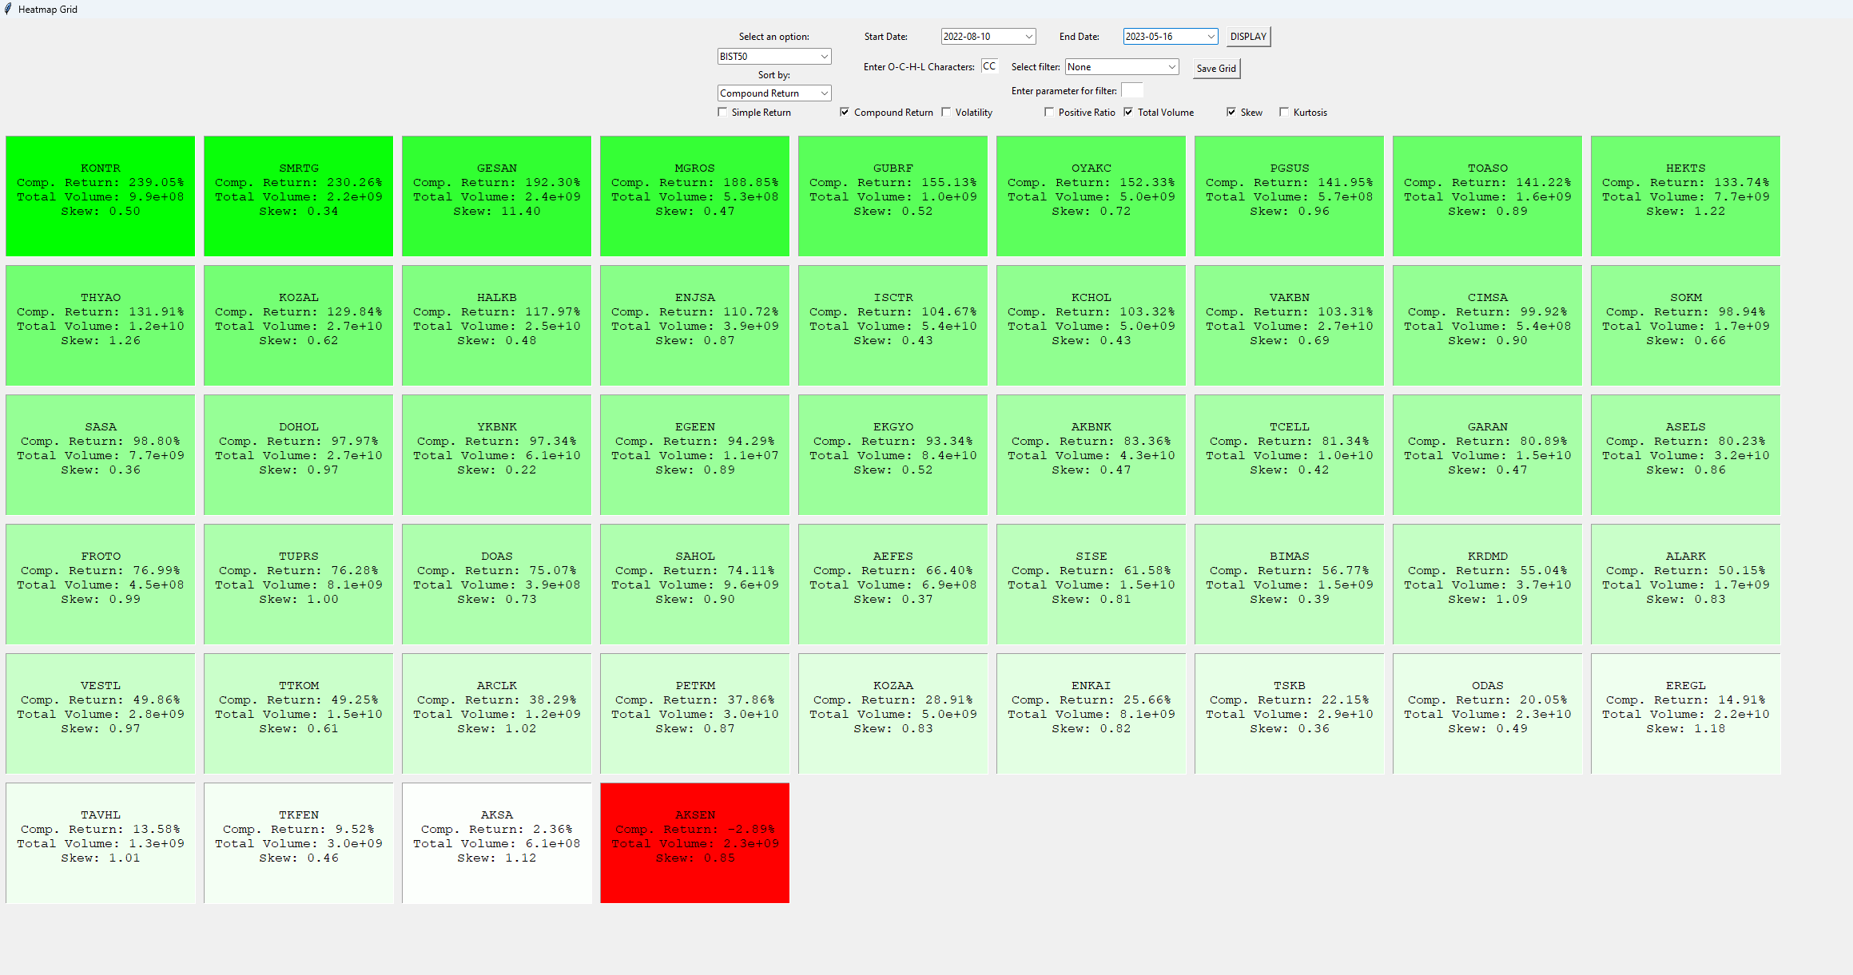
Example

Slide 13
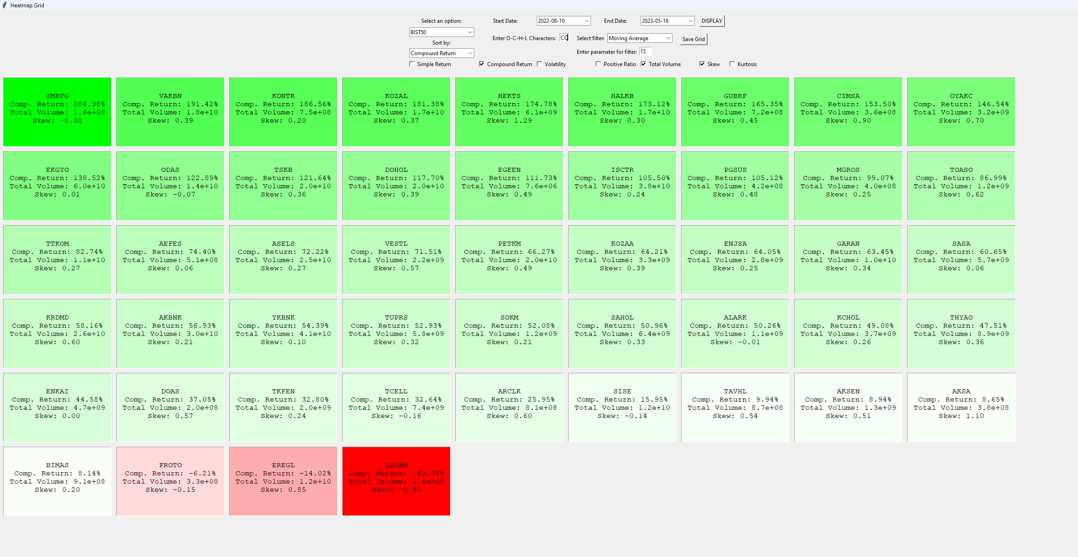
Same Example with Moving Average of 15 days

Slide 14
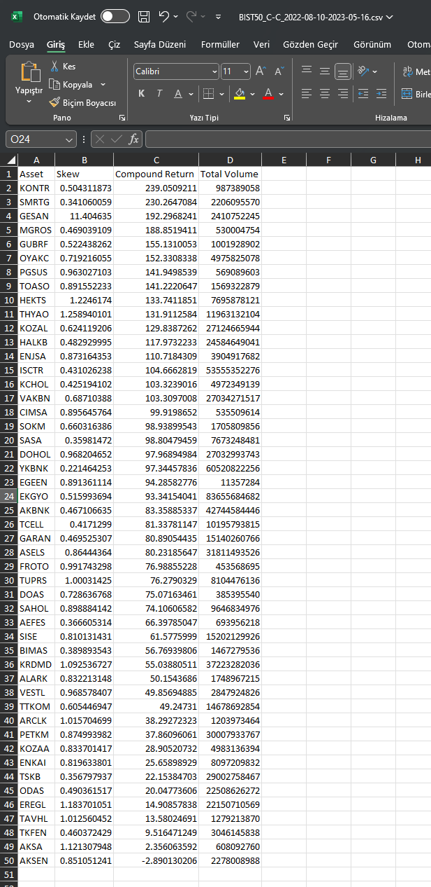
Example, saved with Save Grid Button
The file is named according to the user's inputs.

Slide 15
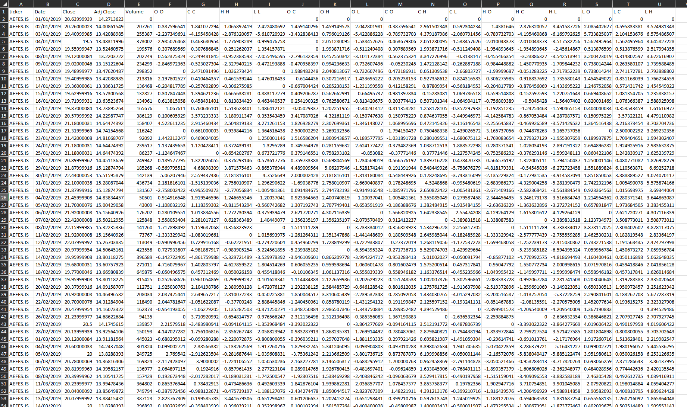
How data is stored
Data is normally stored in a parquet file which is not human readable, but I have exported the dataframe to a csv file to show you.

Slide 16
Thank You For Listening Can Ceylan 29010

